Slide 1
Building an Intuition for Composition
Sy Brand (they/them), @TartanLlama
C++ Developer Advocate, Microsoft
Meeting C++, 2020-11-13

Slide 2





I am bad at maths

Slide 3


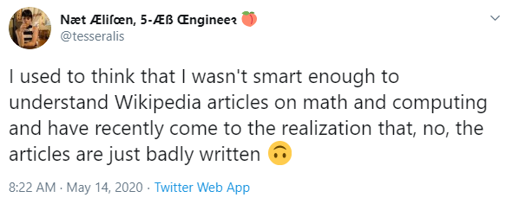




Slide 4


Slide 5
std::accumulate

Slide 6
std::vector<int> v{ 1, 2, 3 };
int sum = accumulate(begin(v), end(v), 0);

Slide 7
std::vector<int> v{ 1, 2, 3 };
int product = accumulate(begin(v), end(v), 1,
multiplies<>());

Slide 8


Slide 9
{1, 2, 3, 4, 5, 6, 7, 8, 9, 10}

Slide 10
+
{1, 2, 3, 4, 5, 6, 7, 8, 9, 10}

Slide 11
+
{ 3, 3, 4, 5, 6, 7, 8, 9, 10}

Slide 12
+
{ 3, 3, 4, 5, 6, 7, 8, 9, 10}

Slide 13
+
{ 6, 4, 5, 6, 7, 8, 9, 10}

Slide 14
+
{ 6, 4, 5, 6, 7, 8, 9, 10}

Slide 15
+
{ 10, 5, 6, 7, 8, 9, 10}

Slide 16

{ }

Slide 17
vector<string> strings {"Hello", " CppCon"};
auto joined = accumulate(begin(strings), end(strings),
""s);

Slide 18
template<class It, class Pred >
bool f(It first, It last, Pred p ) {
return std::accumulate(
first, last, true,
[&](auto lhs, auto rhs) {
return lhs && p(rhs);
});
}

Slide 19
template<class It, class Pred >
bool all_of (It first, It last, Pred p ) {
return std::accumulate(
first, last, true,
[&](auto lhs, auto rhs) {
return lhs && p(rhs);
});
}

Slide 20
template<class It, class Pred >
bool all_of (It first, It last, Pred p ) {
return std::accumulate(
first, last, true,
[&](auto lhs, auto rhs) {
return lhs && p(rhs);
});
}

Slide 21
template<class It, class Pred >
bool none_of (It first, It last, Pred p ) {
return std::accumulate(
first, last, true,
[&](auto lhs, auto rhs) {
return lhs && !p(rhs);
});
}

Slide 22
template<class It, class Pred >
bool none_of (It first, It last, Pred p ) {
return std::accumulate(
first, last, true,
[&](auto lhs, auto rhs) {
return lhs && !p(rhs);
});
}

Slide 23
template<class It, class Pred >
bool any_of (It first, It last, Pred p ) {
return std::accumulate(
first, last, false,
[&](auto lhs, auto rhs) {
return lhs || p(rhs);
});
}

Slide 24


Slide 25
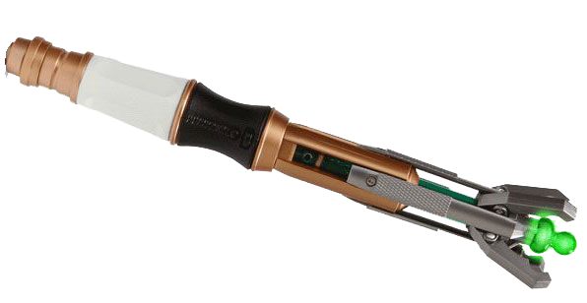

Slide 26
Fold expressions

Slide 27
auto sum(auto&&... ts) {
return (ts + ...);
}

Slide 28
auto sum(auto&&... ts) {
return (ts + ...);
}
sum(1,2,3);

Slide 29
int sum(int a, int b, int c) {
return (((a + b) + c) + 0);
}
sum(1,2,3);

Slide 30
accumulate(begin(v), end(v), 0, plus<>())

Slide 31
accumulate(begin(v), end(v), 0, plus<>())

Slide 32
accumulate(begin(v), end(v), 0, plus<>())

Slide 33
accumulate(begin(v), end(v), 0, plus<>())

Slide 34
accumulate(begin(v), end(v), 0, multiplies<>())

Slide 35
accumulate(begin(v), end(v), 0, multiplies<>())

Slide 36
accumulate(begin(v), end(v), 1, multiplies<>())

Slide 37




IDENTITY

Slide 38
Special element of a set which does not change the other input to a binary operator.
Identity
element

Slide 39
0
int
+

Slide 40
0
0 + i == i
int
+

Slide 41
1
int
*

Slide 42
1
1 * i == i
int
*

Slide 43
“”
“” + s == s
string
+

Slide 44
Empty set
set
union

Slide 45
true
bool
&&

Slide 46
accumulate(begin(v), end(v), 0, plus<>())

Slide 47
accumulate(begin(v), end(v), 0, plus<>())

Slide 48
{1, 2, 3, 4, 5, 6, 7, 8, 9, 10}

Slide 49
{1,2,3,4, 5,6,7,8, 9,10} 0 (id)

Slide 50
10 26 19 0

Slide 51
10 26 19 0
36
19

Slide 52
10 26 19 0
36
19
55

Slide 53
-
{1, 2, 3, 4, 5, 6, 7, 8, 9, 10}

Slide 54
-
{ -1, 3, 4, 5, 6, 7, 8, 9, 10}

Slide 55
-
{ -4, 4, 5, 6, 7, 8, 9, 10}

Slide 56
{ -53}

Slide 57
{1,2,3,4, 5,6,7,8, 9,10} 0 (id)

Slide 58
-8 -16 -1 0
-24
-1
-23

Slide 59
Associativity

Slide 60
An operator where the grouping of operands does not matter.
Associativity

Slide 61
(a * b) * c = a * (b * c)
Associativity

Slide 62
std::reduce

Slide 63
A data type
A binary operator
Associative
Returns the same type as its arguments
Identity element

Slide 64
A data type
A binary operator
Associative
Returns the same type as its arguments
Identity element
Monoid

Slide 65

If you have types you are composing often, you may be able to expose a monoid.

Slide 66

Clearly define object composition
Turn binary functions into n-ary functions
Unlock parallelism

Slide 67
using word_count = std::unordered_map<std::string, long>;

Slide 68
using word_count = std::unordered_map<std::string, long>;
auto count_words(std::string sv) -> word_count;

Slide 69
using word_count = std::unordered_map<std::string, long>;
auto count_words(std::string sv) -> word_count;
auto map_merger(word_count lhs, word_count rhs) -> word_count;

Slide 70
std::string text;
auto chunked = chunk(text, distributed_system::n_machines);

Slide 71
std::string text;
auto chunked = chunk(text, distributed_system::n_machines);
std::transform_reduce(distributed_system,
begin(chunked), end(chunked),
std::unordered_map<std::string,long>{},
map_merger, count_words);

Slide 72
std::string text;
auto chunked = chunk(text, distributed_system::n_machines);
std::transform_reduce(distributed_system,
begin(chunked), end(chunked),
std::unordered_map<std::string,long>{},
map_merger, count_words);

Slide 73
std::string text;
auto chunked = chunk(text, distributed_system::n_machines);
std::transform_reduce(distributed_system,
begin(chunked), end(chunked),
std::unordered_map<std::string,long>{},
map_merger, count_words);

Slide 74
std::string text;
auto chunked = chunk(text, distributed_system::n_machines);
std::transform_reduce(distributed_system,
begin(chunked), end(chunked),
std::unordered_map<std::string,long>{},
map_merger, count_words);

Slide 75
std::string text;
auto chunked = chunk(text, distributed_system::n_machines);
std::transform_reduce(distributed_system,
begin(chunked), end(chunked),
std::unordered_map<std::string,long>{},
map_merger, count_words);

Slide 76
auto map_merger(word_count lhs, word_count rhs) {
}

Slide 77
auto map_merger(word_count lhs, word_count rhs) {
for (auto&& [k,v] : rhs) {
}
}

Slide 78
auto map_merger(word_count lhs, word_count rhs) {
for (auto&& [k,v] : rhs) {
if (lhs.contains(k)) {
lhs[k] += v;
}
}

Slide 79
auto map_merger(word_count lhs, word_count rhs) {
for (auto&& [k,v] : rhs) {
if (lhs.contains(k)) {
lhs[k] += v;
}
else {
lhs.emplace(k, v);
}
}
}

Slide 80
auto map_merger(word_count lhs, word_count rhs) {
for (auto&& [k,v] : rhs) {
if (lhs.contains(k)) {
lhs[k] += v;
}
else {
lhs.emplace(k, v);
}
}
return lhs;
}

Slide 81
auto map_merger(word_count lhs, word_count rhs) {
for (auto&& [k,v] : rhs) {
if (lhs.contains(k)) {
lhs[k] += v;
}
else {
lhs.emplace(k, v);
}
}
return lhs;
}

Slide 82
template <class F = std::plus<>>
auto map_merger(word_count lhs, word_count rhs) {
for (auto&& [k,v] : rhs) {
if (lhs.contains(k)) {
lhs[k] += v;
}
else {
lhs.emplace(k, v);
}
}
return lhs;
}

Slide 83
template <class F = std::plus<>>
auto map_merger(F binop = {}) {
for (auto&& [k,v] : rhs) {
if (lhs.contains(k)) {
lhs[k] += v;
}
else {
lhs.emplace(k, v);
}
}
return lhs;
}

Slide 84
template <class F = std::plus<>>
auto map_merger(F binop = {}) {
return [binop](word_count lhs, word_count rhs) {
for (auto&& [k,v] : rhs) {
if (lhs.contains(k)) {
lhs[k] += v;
}
else {
lhs.emplace(k, v);
}
}
return lhs;
};
}

Slide 85
template <class F = std::plus<>>
auto map_merger(F binop = {}) {
return [binop](word_count lhs, word_count rhs) {
for (auto&& [k,v] : rhs) {
if (lhs.contains(k)) {
lhs[k] = binop(lhs[k], v);
}
else {
lhs.emplace(k, v);
}
}
return lhs;
};
}

Slide 86
template <class F = std::plus<>>
auto map_merger(F binop = {}) {
return [binop](auto lhs, auto rhs) {
for (auto&& [k,v] : rhs) {
if (lhs.contains(k)) {
lhs[k] = binop(lhs[k], v);
}
else {
lhs.emplace(k, v);
}
}
return lhs;
};
}

Slide 87
vector<int> is;
accumulate(
begin(is), end(is),
0,
[](auto a, auto b){
return max(a,b);
});

Slide 88
vector<int> is;
max_element(
begin(is), end(is));

Slide 89
struct session {
std::string presenter;
std::string title;
std::chrono::utc_time start_time;
std::chrono::minutes duration;
};
std::vector<session> sessions;

Slide 90
template <class F>
auto order_by(F f);
max_element(sessions, order_by(&session::presenter));

Slide 91
auto operator| (auto f1, auto f2) {
}

Slide 92
auto operator| (auto f1, auto f2) {
return [f1, f2] (auto a, auto b) {
};
}

Slide 93
auto operator| (auto f1, auto f2) {
return [f1, f2] (auto a, auto b) {
if (auto res = f1(a, b);
) {
}
};
}

Slide 94
auto operator| (auto f1, auto f2) {
return [f1, f2] (auto a, auto b) {
if (auto res = f1(a, b);
res != std::weak_ordering::equivalent) {
}
};
}

Slide 95
auto operator| (auto f1, auto f2) {
return [f1, f2] (auto a, auto b) {
if (auto res = f1(a, b);
res != std::weak_ordering::equivalent) {
return res;
}
};
}

Slide 96
auto operator| (auto f1, auto f2) {
return [f1, f2] (auto a, auto b) {
if (auto res = f1(a, b);
res != std::weak_ordering::equivalent) {
return res;
}
return f2(a, b);
};
}

Slide 97
vector<session> sessions;
max_element(sessions,
order_by(&session::presenter)
| order_by(&session::title));

Slide 98
auto ordering_identity = [] (auto, auto) {
return std::weak_ordering::equivalent;
};

Slide 99
auto compose_orderings(auto... fs) {
return (fs | ... | ordering_identity);
}

Slide 100

Ben Deane
@ben_deane
Has lots of talks on monoids
Is awesome

Slide 101
Monoids in Statistics
averages (regular or decayed)
top-N calculations
histograms
bloom filters
Gaussian distributions
count-min sketch
Hyperloglog

Slide 102
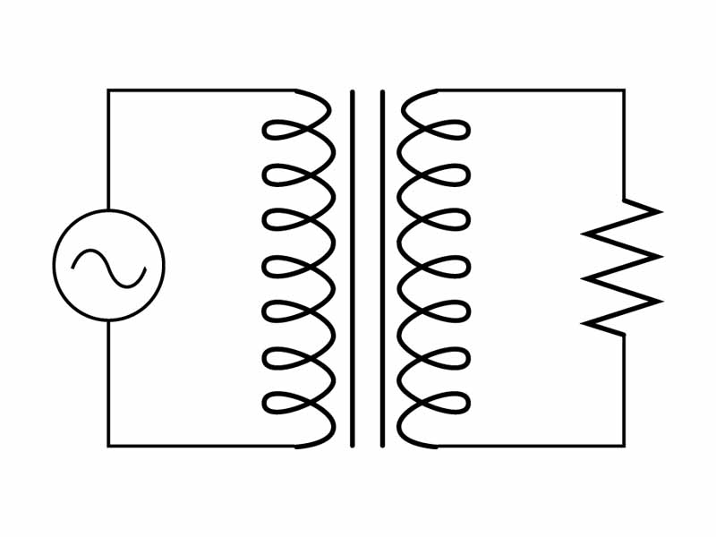

Slide 103
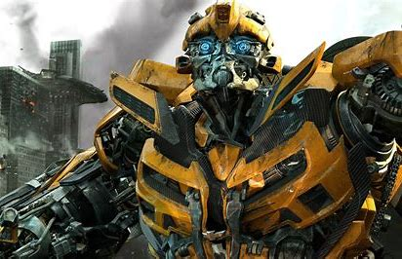

Slide 104
std::transform

Slide 105
std::ranges
::views
::transform

Slide 106

vector<cat> cats;
vector<cat> cute_cats;
for (auto& cat : cats) {
cute_cats.push_back(make_cute(cat));
}

Slide 107
vector<cat> cats;
auto cute_cats = cats | transform(make_cute);

Slide 108
optional<cat> c;
if (c) {
auto cute_cat = make_cute(*c);
//...
}

Slide 109
optional<cat> c;
auto cute_cat = c | transform(make_cute);
//...

Slide 110
vector<cat> cats;
auto cute_cats = cats | transform(make_cute);

Slide 111
future<cat> f = async(get_cat);
f.wait();
auto cute_cat = make_cute(f.get());

Slide 112
future<cat> f = async(get_cat);
auto cute_cat = f | transform(make_cute);

Slide 114


Slide 115
template <template <class> class Templ,
class T, class R>
auto transform(Templ<T> t,
function<R(T)>)
-> Templ<R>;

Slide 116
template <template <class> class Templ,
class T, class R>
auto transform(Templ<T> t,
function<R(T)>)
-> Templ<R>;

Slide 117
template <template <class> class Templ,
class T, class R>
auto transform(Templ<T> t,
function<R(T)>)
-> Templ<R>;

Slide 118
template <template <class> class Templ,
class T, class R>
auto transform(Templ<T> t,
function<R(T)>)
-> Templ<R>;

Slide 119
template <template <class> class Templ,
class T, class R>
auto transform(Templ<T> t,
function<R(T)>)
-> Templ<R>;

Slide 120
template <template <class> class Templ,
class T, class R>
auto transform(Templ<T> t,
function<R(T)>)
-> Templ<R>;

Slide 121
template <template <class> class Templ,
class T, class R>
auto map(Templ<T> t,
function<R(T)>)
-> Templ<R>;

Slide 122
template <template <class> class Templ,
class T, class R>
auto fmap(Templ<T> t,
function<R(T)>)
-> Templ<R>;

Slide 123
A container of Ts
A function which transforms the Ts inside the container

Slide 124
Ts in some computational context
A function which transforms the Ts while maintaining the context

Slide 125
Ts in some computational context
A function which transforms the Ts while maintaining the context
Functor

Slide 126
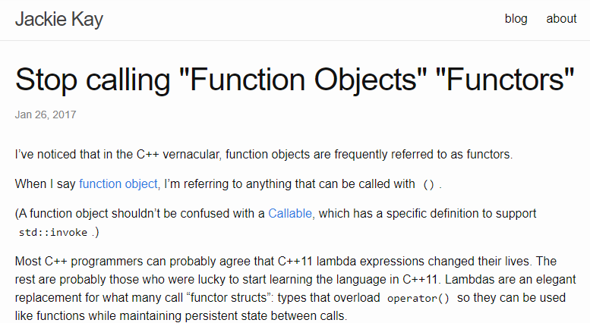

Slide 127
Functor Laws

Slide 128
auto id = [](auto t) { return t; };

Slide 129
auto id = [](auto t) { return t; };
(functor | transform(id)) == functor;

Slide 130
auto id = [](auto t) { return t; };
(vec | transform(id)) == vec;

Slide 131
functor | transform(f) | transform(g)

Slide 132
functor | transform(f) | transform(g)
==
functor | transform(compose(f,g));

Slide 133
vec | transform(f) | transform(g)
==
vec | transform(compose(f,g));

Slide 134
If you have types you’re manipulating the structure of just to change the values, you may be able to expose a functor.

Slide 135
Abstract away handling of context
Write code at the level of intent

Slide 136
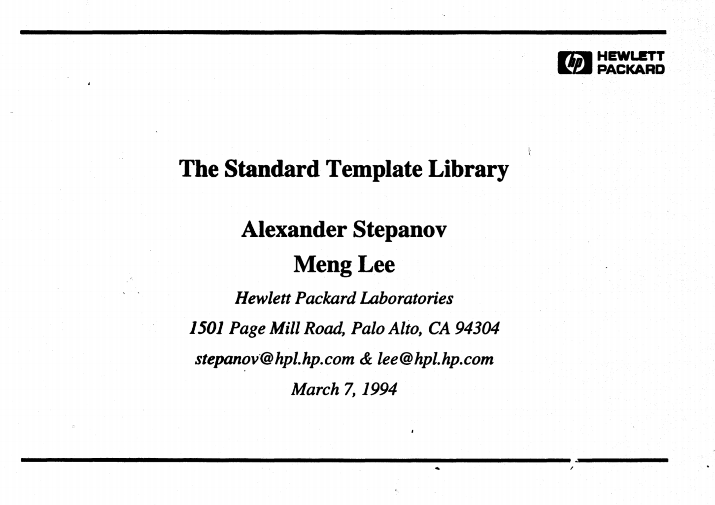

Slide 137
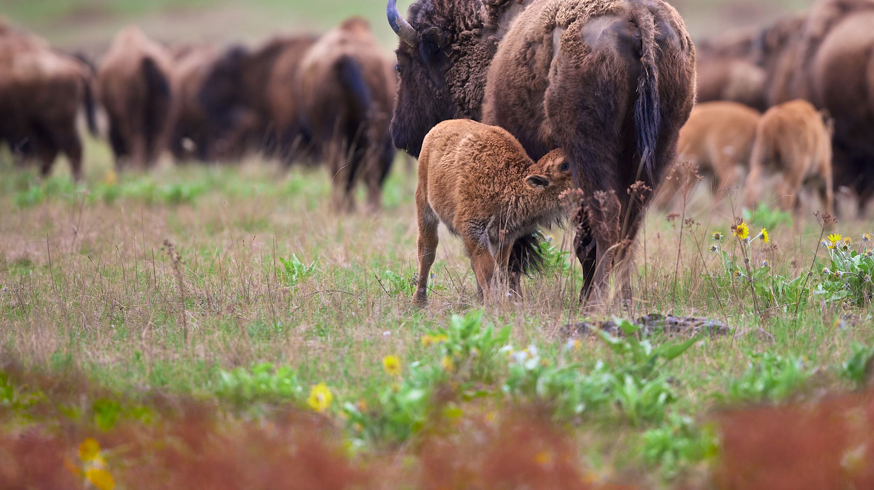
Ranges in C++ are functors

Slide 138
Is this type a range? Does it expose anything which is a range?

Slide 139
std::ranges
::views
::join

Slide 140
auto make_smaller(cat_pic) -> cat_pic;
auto make_eyes_sparkle(cat_pic) -> optional<cat_pic>;

Slide 141
auto make_smaller(cat_pic) -> cat_pic;
auto make_eyes_sparkle(cat_pic) -> optional<cat_pic>;
optional<cat_pic> maybe_cat;

Slide 142
auto make_smaller(cat_pic) -> cat_pic;
auto make_eyes_sparkle(cat_pic) -> optional<cat_pic>;
optional<cat_pic> maybe_cat;
auto cute_cat = maybe_cat | transform(make_eyes_sparkle)
| transform(make_smaller);

Slide 143
auto make_smaller(cat_pic) -> cat_pic;
auto make_eyes_sparkle(cat_pic) -> optional<cat_pic>;
optional<cat_pic> maybe_cat;
auto cute_cat = maybe_cat | transform(make_eyes_sparkle)
| transform(make_smaller);

Slide 144
auto make_smaller(cat_pic) -> cat_pic;
auto make_eyes_sparkle(cat_pic) -> optional<cat_pic>;
optional<cat_pic> maybe_cat;
auto cute_cat = maybe_cat | transform(make_eyes_sparkle)
| join
| transform(make_smaller);

Slide 145
auto make_smaller(cat_pic) -> cat_pic;
auto make_eyes_sparkle(cat_pic) -> optional<cat_pic>;
optional<cat_pic> maybe_cat;
auto cute_cat = maybe_cat | transform(make_eyes_sparkle)
| join
| transform(add_top_hat)
| join
| transform(make_smaller);

Slide 146
auto make_smaller(cat_pic) -> cat_pic;
auto make_eyes_sparkle(cat_pic) -> optional<cat_pic>;
optional<cat_pic> maybe_cat;
auto cute_cat = maybe_cat | and_then(make_eyes_sparkle)
| and_then(add_top_hat)
| transform(make_smaller);

Slide 147
auto make_smaller(cat_pic) -> cat_pic;
auto make_eyes_sparkle(cat_pic) -> optional<cat_pic>;
optional<cat_pic> maybe_cat;
if (maybe_cat) {
if (auto sparkly_cat = make_eyes_sparkle(*maybe_cat); sparkly_cat) {
if (auto top_hat_cat = add_top_hat(*sparkly_cat); top_hat_cat) {
auto cute_cat = make_smaller(*top_hat_cat);
//...
}
}
}

Slide 148
auto pat_head(cat) -> future<cat>;
auto scratch_belly(cat) -> future<cat>;

Slide 149
auto pat_head(cat) -> future<cat>;
auto scratch_belly(cat) -> future<cat>;
cat goode_boye;

Slide 150
auto pat_head(cat) -> future<cat>;
auto scratch_belly(cat) -> future<cat>;
cat goode_boye;
auto yes_he_is = pat_head(goode_boye)
| and_then(scratch_belly);

Slide 151
A Parser for Things is a function from Strings to Lists of Pairs of Things and Strings!
– Fritz Ruehr, Willamette University

Slide 152
auto match_char(char c) {
return [=](string input) {
list<pair<char, string>> result;
if (input.empty() || input[0] != c)
return result;
result.push_front(pair{c, input.substr(1)});
return result;
};
}

Slide 153
std::string input = "hello";
auto parser = match_char('h');
auto [c, rest] = parser(input).front();
assert(c == 'h');
assert(rest == "ello");

Slide 154
auto parser = match_one_of('t', 'f')
| and_then([](char c) {
c == 't' ? return match_string("rue")
: return match_string("alse");
});

Slide 155
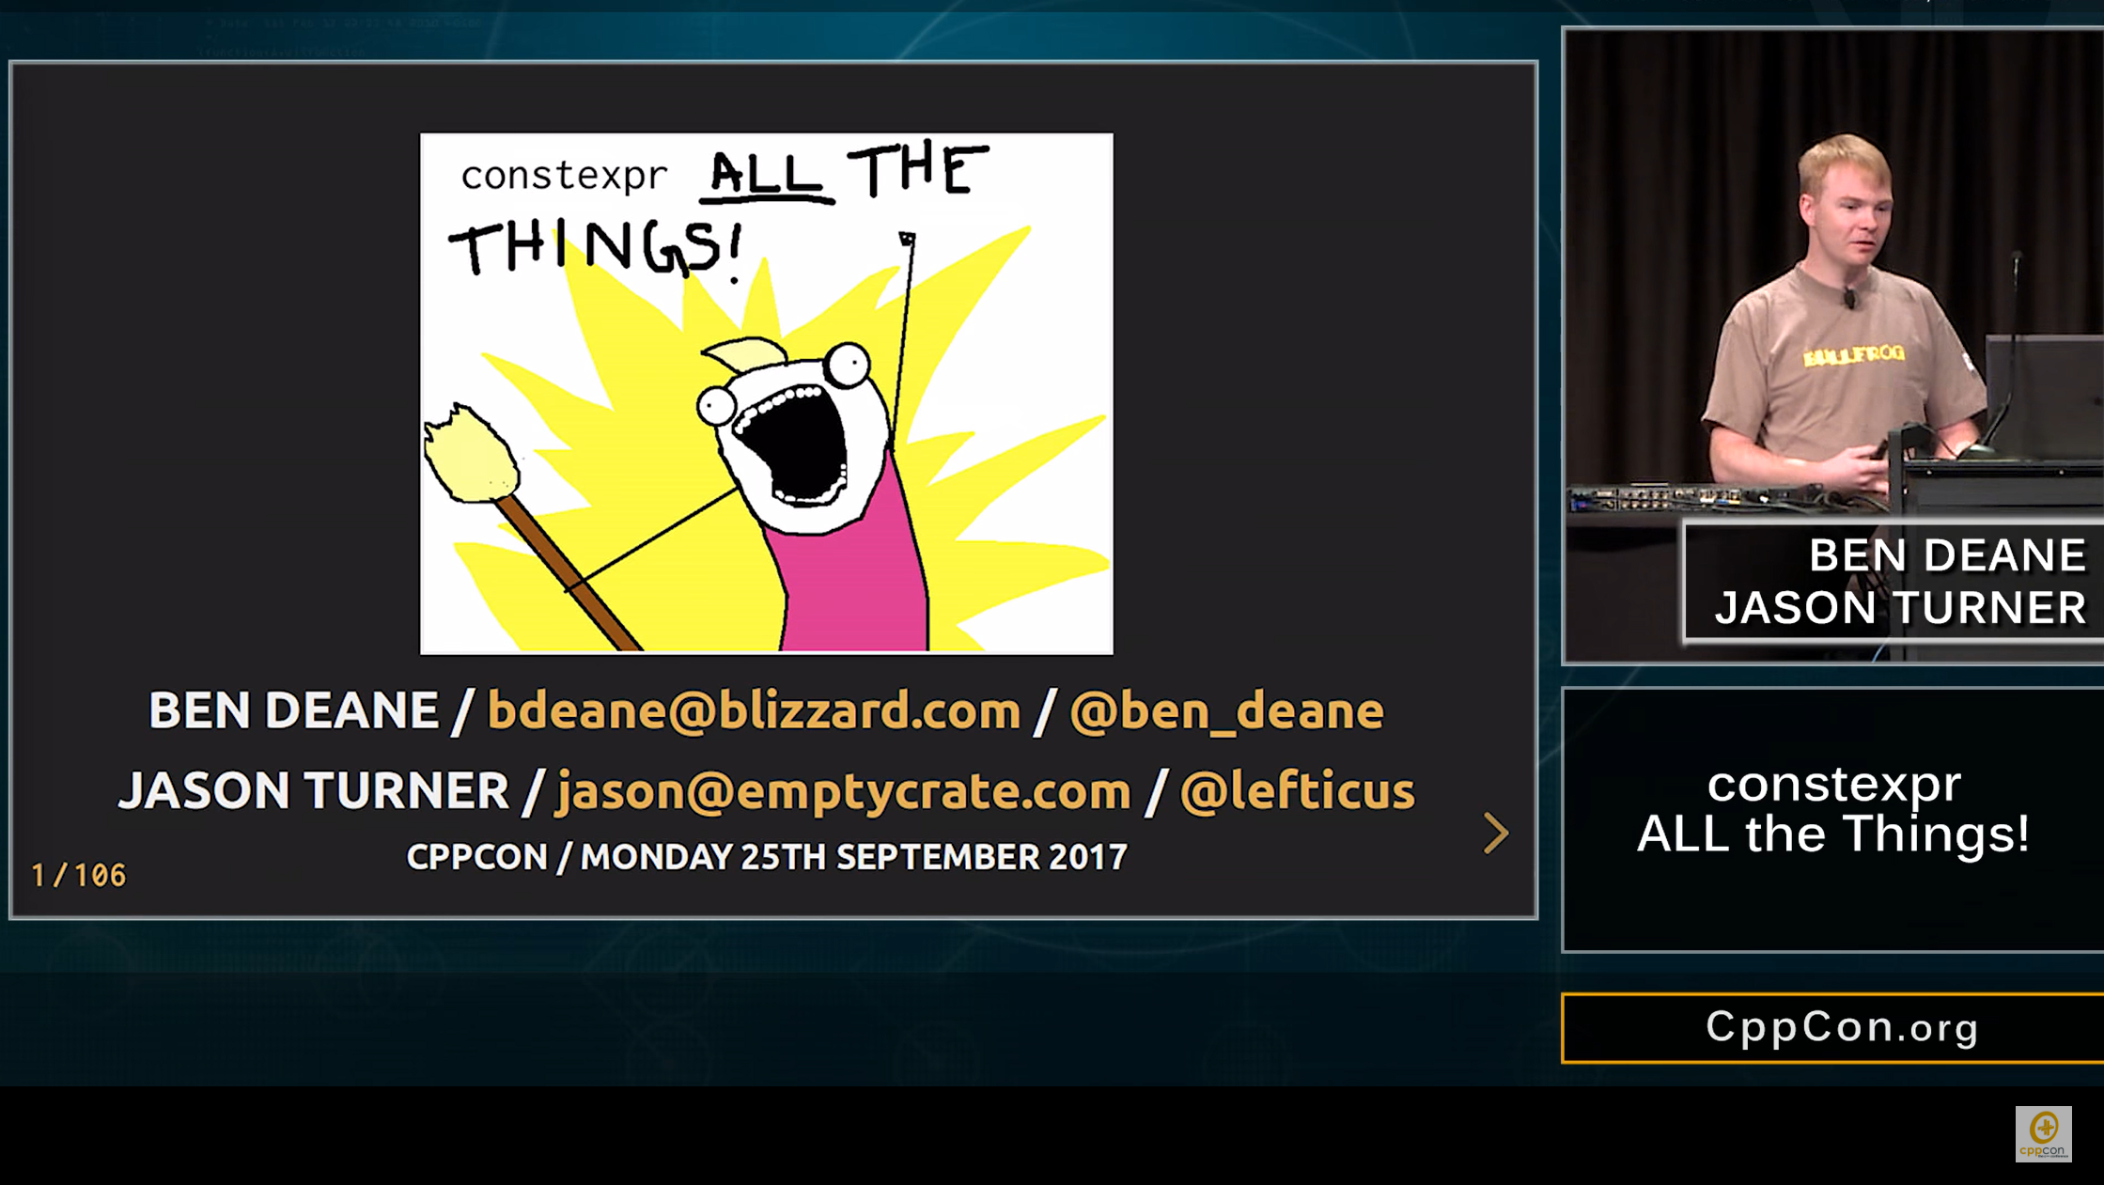

Slide 156
auto int_parser = one_of("123456789")
| and_then(
[] (char x) {
return many(one_of("0123456789"),
static_cast<int>(x - '0'),
[] (int acc, char c) {
return (acc*10) + (c-'0');
});
});
}

Slide 158
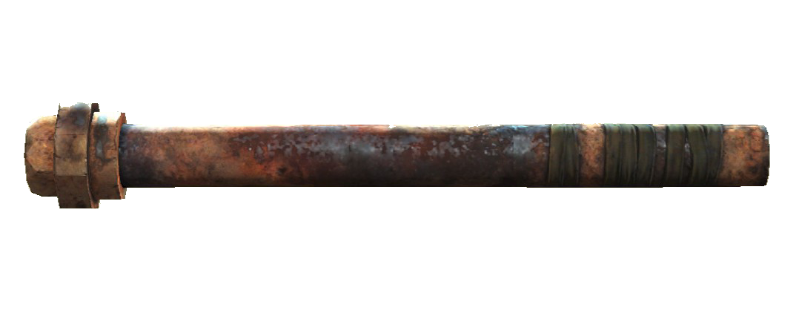
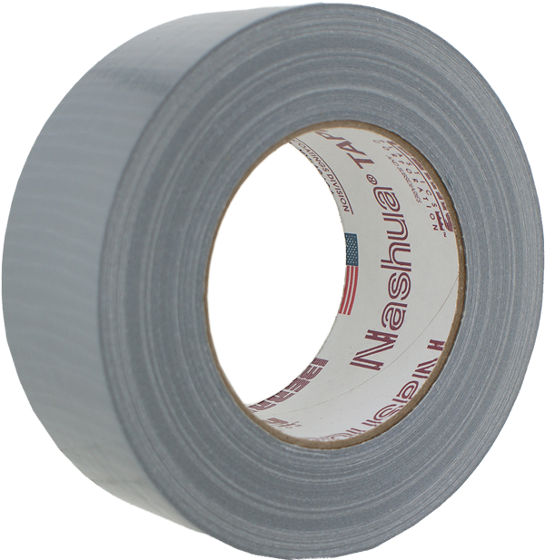

Slide 159
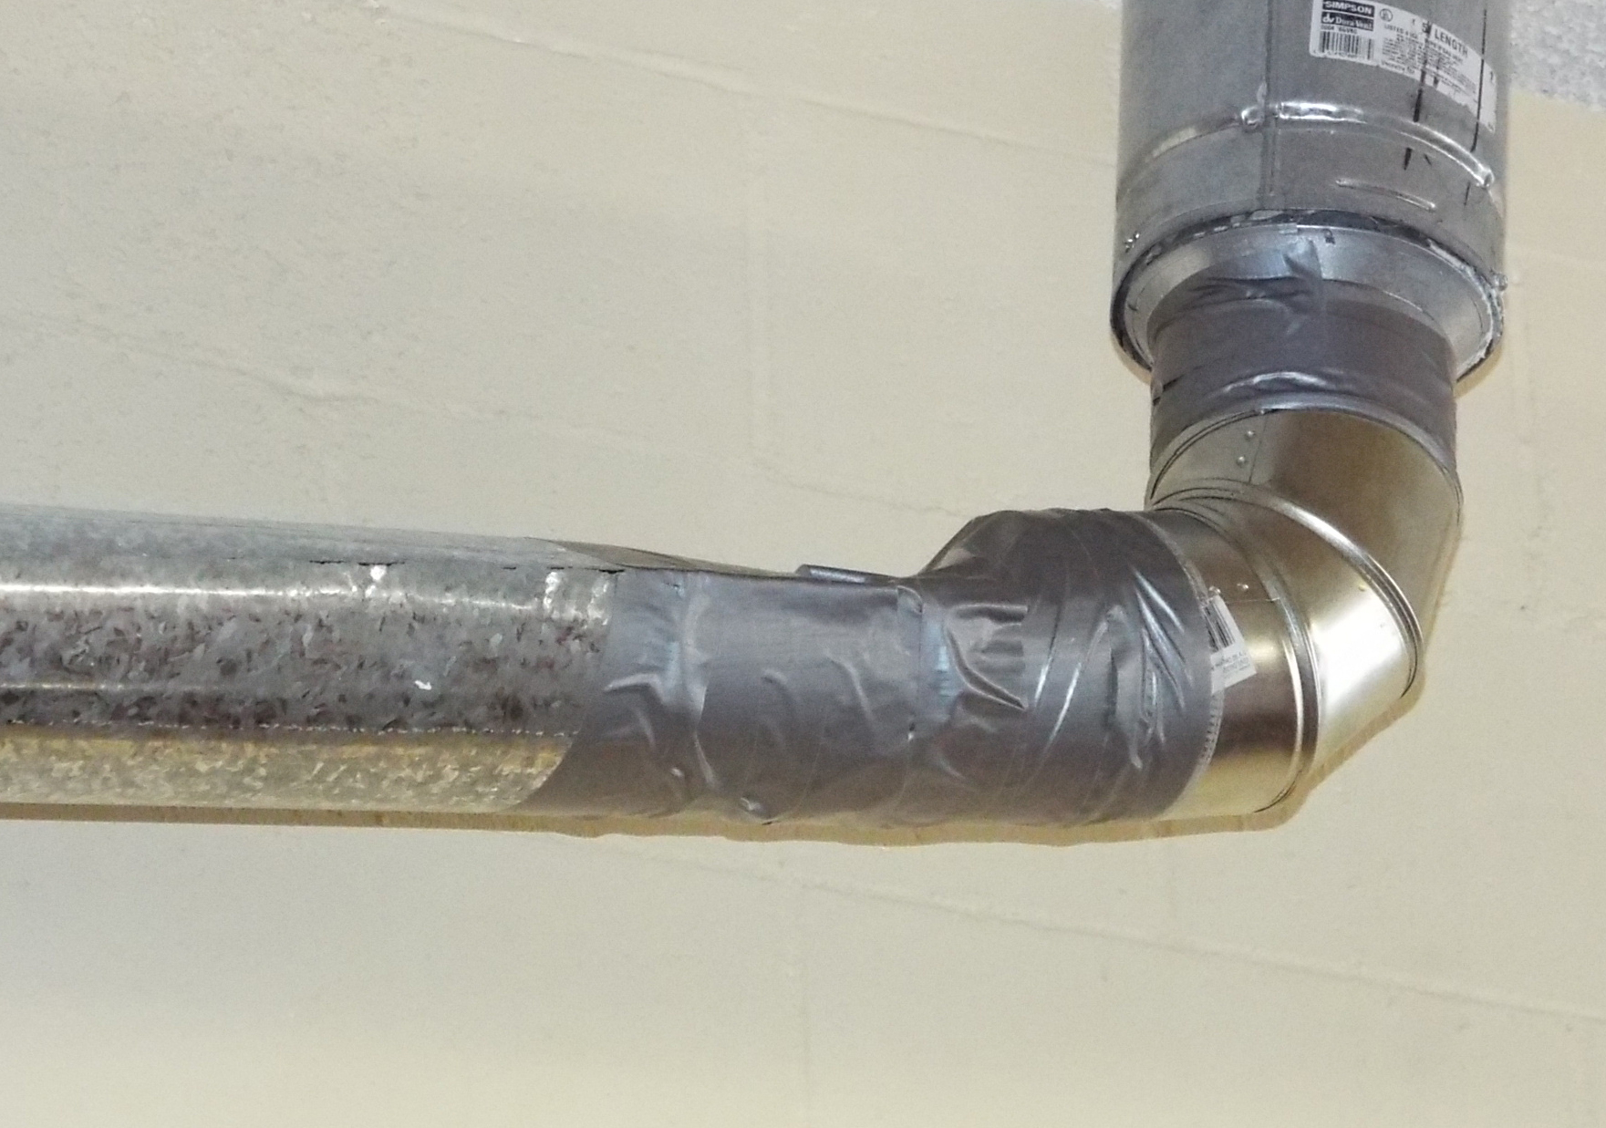

Slide 160
Ts in some computational context
A function which composes operations producing that context

Slide 161
Ts in some computational context
A function which composes operations producing that context
Monad

Slide 162

Didn’t make a monad joke

Slide 163
Monad Laws

Slide 164

Monad Laws

Slide 165
If you are manually marshalling data in and out of contexts to manipulate them, you may be able to expose a monad.

Slide 166
Abstract away handling of context
Write code at the level of intent

Slide 167
Coroutines

Slide 168
int64_t tcp_reader(int64_t total) {
std::array<char, 4096> buffer;
tcp::connection the_connection =
tcp::connect("127.0.0.1", 1337);
int64_t remaining = total;
for (;;) {
int64_t bytes_read =
the_connection.read(buffer.data(), buffer.size());
remaining -= bytes_read;
if (remaining <= 0 || bytes_read == 0) {
return remaining;
}
}
}

Slide 169
int64_t tcp_reader(int64_t total) {
std::array<char, 4096> buffer;
tcp::connection the_connection =
tcp::connect("127.0.0.1", 1337);
int64_t remaining = total;
for (;;) {
int64_t bytes_read =
the_connection.read(buffer.data(), buffer.size());
remaining -= bytes_read;
if (remaining <= 0 || bytes_read == 0) {
return remaining;
}
}
}

Slide 170
int64_t tcp_reader(int64_t total) {
std::array<char, 4096> buffer;
tcp::connection the_connection =
tcp::connect("127.0.0.1", 1337);
int64_t remaining = total;
for (;;) {
int64_t bytes_read =
the_connection.read(buffer.data(), buffer.size());
remaining -= bytes_read;
if (remaining <= 0 || bytes_read == 0) {
return remaining;
}
}
}

Slide 171
std::future<int64_t> tcp_reader(int64_t total) {
struct reader_state {
std::array<char, 4096> _buffer;
int64_t _remaining;
tcp::connection _connection;
explicit reader_state(int64_t total) : _remaining(total) {}
};
auto state = std::make_shared<reader_state>(total);
return tcp::connect("127.0.0.1", 1337).then(
[state](std::future<tcp::connection> the_connection) {
state->_connection = std::move(the_connection.get());
return do_while([state]() -> std::future<bool> {
if (state->_remaining <= 0) { return std::make_ready_future(false); }
return state->conn.read(state->_buffer.data(), sizeof(state->_buffer)).then(
[state](std::future<int64_t> bytes_read_future) {
int64_t bytes_read = bytes_read_future.get();
if (bytes_read == 0) { return std::make_ready_future(false); }
state->_remaining -= bytes_read;
return std::make_ready_future(true);
});
});
});
}

Slide 172
int64_t tcp_reader(int64_t total) {
std::array<char, 4096> buffer;
tcp::connection the_connection =
tcp::connect("127.0.0.1", 1337);
int64_t remaining = total;
for (;;) {
int64_t bytes_read =
the_connection.read(buffer.data(), buffer.size());
remaining -= bytes_read;
if (remaining <= 0 || bytes_read == 0) {
return remaining;
}
}
}

Slide 173
int64_t tcp_reader(int64_t total) {
std::array<char, 4096> buffer;
tcp::connection the_connection = co_await
tcp::connect("127.0.0.1", 1337);
int64_t remaining = total;
for (;;) {
int64_t bytes_read = co_await
the_connection.read(buffer.data(), buffer.size());
remaining -= bytes_read;
if (remaining <= 0 || bytes_read == 0) {
return remaining;
}
}
}

Slide 174
task<int64_t> tcp_reader(int64_t total) {
std::array<char, 4096> buffer;
tcp::connection the_connection = co_await
tcp::connect("127.0.0.1", 1337);
int64_t remaining = total;
for (;;) {
int64_t bytes_read = co_await
the_connection.read(buffer.data(), buffer.size());
remaining -= bytes_read;
if (remaining <= 0 || bytes_read == 0) {
return remaining;
}
}
}

Slide 175
// https://github.com/toby-allsopp/coroutine_monad
optional<int> f1() { return 7; }
optional<double> f2(int x) { return 2.0 * x; }
optional<int> f3(int x, double y) { return nullopt; }

Slide 176
// https://github.com/toby-allsopp/coroutine_monad
optional<int> f1() { return 7; }
optional<double> f2(int x) { return 2.0 * x; }
optional<int> f3(int x, double y) { return nullopt; }
optional<int> optional_coroutine() {
auto x = co_await f1();
auto y = co_await f2(x);
auto z = co_await f3(x, y);
co_return z;
}

Slide 177
Static Exceptions

Slide 178
int convert(const string& str) throws {
if (str.empty())
throw ConversionErrc::EmptyString;
if (!std::all_of(str.begin(), str.end(), ::isdigit))
throw ConversionErrc::IllegalChar;
return atoi(str.c_str());
}
int str_multiply(const string& s, int i) throws {
auto result = convert(s);
return result * i;
}

Slide 179
int convert(const string& str) throws {
if (str.empty())
throw ConversionErrc::EmptyString;
if (!std::all_of(str.begin(), str.end(), ::isdigit))
throw ConversionErrc::IllegalChar;
return atoi(str.c_str());
}
int str_multiply(const string& s, int i) throws {
auto result = convert(s);
return result * i;
}

Slide 180
int convert(const string& str) throws {
if (str.empty())
throw ConversionErrc::EmptyString;
if (!std::all_of(str.begin(), str.end(), ::isdigit))
throw ConversionErrc::IllegalChar;
return atoi(str.c_str());
}
int str_multiply(const string& s, int i) throws {
auto result = convert(s);
return result * i;
}

Slide 181
int convert(const string& str) throws {
if (str.empty())
throw ConversionErrc::EmptyString;
if (!std::all_of(str.begin(), str.end(), ::isdigit))
throw ConversionErrc::IllegalChar;
return atoi(str.c_str());
}
int str_multiply(const string& s, int i) throws {
auto result = convert(s);
return result * i;
}

Slide 182
expected<int,error> convert(const string& str) {
if (str.empty())
return unexpected(ConversionErrc::EmptyString);
if (!std::all_of(str.begin(), str.end(), ::isdigit))
return unexpected(ConversionErrc::IllegalChar);
return atoi(str.c_str());
}
int str_multiply(const string& s, int i) throws {
auto result = convert(s);
return result * i;
}

Slide 183
expected<int,error> convert(const string& str) {
if (str.empty())
return unexpected(ConversionErrc::EmptyString);
if (!std::all_of(str.begin(), str.end(), ::isdigit))
return unexpected(ConversionErrc::IllegalChar);
return atoi(str.c_str());
}
expected<int,error> str_multiply(const string& s, int i) {
auto result = convert(s);
return result * i;
}

Slide 184
expected<int,error> convert(const string& str) {
if (str.empty())
return unexpected(ConversionErrc::EmptyString);
if (!std::all_of(str.begin(), str.end(), ::isdigit))
return unexpected(ConversionErrc::IllegalChar);
return atoi(str.c_str());
}
expected<int,error> str_multiply(const string& s, int i) {
return convert(s)
| transform([i](int result){ return result * i; });
}

Slide 185
int convert(const string& str) throws {
if (str.empty())
throw ConversionErrc::EmptyString;
if (!std::all_of(str.begin(), str.end(), ::isdigit))
throw ConversionErrc::IllegalChar;
return atoi(str.c_str());
}
int str_multiply(const string& s, int i) throws {
auto result = convert(s);
return result * i;
}

Slide 186
A data type
A binary operator
Associative
Returns the same type as its arguments
Identity element
Monoid

Slide 187
Ts in some computational context
A function which transforms the Ts while maintaining the context
Functor

Slide 188
Ts in some computational context
A function which composes operations producing that context
Monad

Slide 189
Look out for monoids, functors and monads in your code.

Slide 190
Expose them in your API to allow:
The clear expression of composition.
Writing code at the level of intent.

Slide 191
Building an Intuition for Composition
Sy Brand (they/them), @TartanLlama
C++ Developer Advocate, Microsoft
Meeting C++, 2020-11-13

